Slide 1

LY TU TRONG TECHNICAL COLLEGE
HO CHI MINH CITY
390 HOANG VAN THU, WARD 4, TAN BINH DISTRICT, HCMC
TEL: (848)-8440567; (848)-4490589
www.lttc.edu.vn

Slide 2
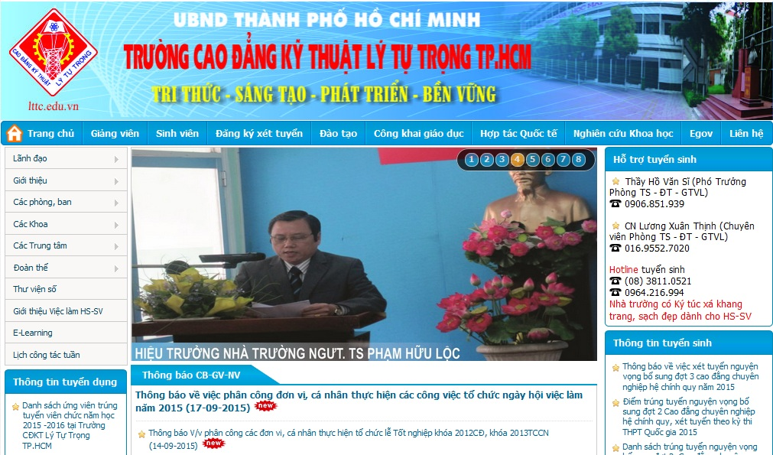
OFFICIAL WEBSITE OF LY TU TRONG TECHNICAL COLLEGE
HO CHI MINH CITY

Slide 3
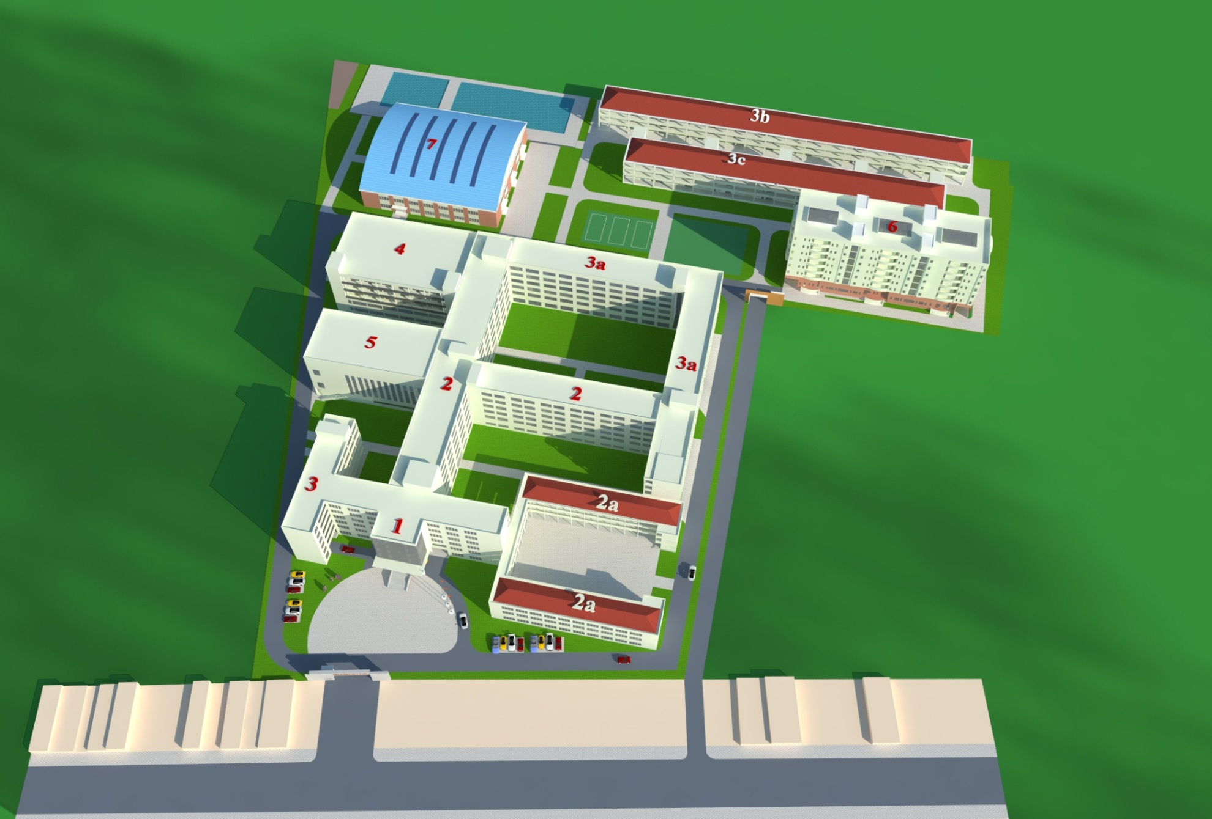
FUTURE OVERALL PLANNING OF LY TU TRONG TECHNICAL COLLEGE HO CHI MINH CITY

Slide 4
CONTENT
1
HISTORY AND DEVELOPMENT
2
ACADEMIC PROGRAMS
3
ORGANIZATION
4
STAFF & TEACHERS
5
FIELDS OF TRAINING
6
QUI MÔ ĐÀO TẠO

Slide 5

HISTORY AND DEVELOPMENT
02-2005
Ly Tu Trong Tehnical College Ho Chi Minh City
03-1999
03-1995
Ly Tu Trong Technical High School
02-1986
Ly Tu Trong Vocational Training High School
Ly Tu Trong Vocational Training School

Slide 6
ACADEMIC PROGRAMS
COLLEGE DEGREE
HIGH SCHOOL
TECHNICIAN DEGREE
TRƯỜNG
CAO ĐẲNG
KỸ THUẬT
LÝ TỰ TRỌNG
TP.HCM
SHORT-TERM TRAINING
COLLEGE DEGREE (TRANSFER)

Slide 7
ORGANIZATION
BOARD OF COMMUNIST PARTY LEADERS
LABOUR UNION
ACADEMIC – SCIENTIFIC COMMITEE
BOARD OF
ADMINISTRATORS
YOUTH AND STUDENT UNIONS
COLLEGE COMMITEE

Slide 8

8 DEPARTMENTS
DEPARTMENTS
ORGANIZATION AND ADMINISTRATION
ACADEMIC AFFAIRS
EDUCATION INSPECTION – STUDENT AFFAIRS
FINANCIAL PLANNING
TESTING - QUALITY ASSURANCE
FACILITY SUPPLY
SCIENTIFIC MANAGEMENT – INTERNATIONAL CORPORATION
FACILITY MANAGEMENT - SERVICE

Slide 9

FACULTIES
FOUNDATION SCIENCE
INFORMATION TECHNOLOGY
MECHANICAL ENGINEERING TECHNOLOGY
ELECTRICAL-ELECTRONICS ENGINEERING TECHNOLOGY
HEAT-REFRIGERATION ENGINEERING TECHNOLOGY
AUTOMOTIVE ENGINEERING TECHNOLOGY
GARMENT TECHNOLOGY-FASHION
POLITICAL THEORIES
ECONOMICS

Slide 10
HIGH SCHOOL - CENTERS
LY TU TRONG HIGH SCHOOL
INFORMATION CENTER - LIBRARY
LY TU TRONG TRAINING CENTER
TECHNOLOGY RESEARCH & TRANSFER CENTER
REGULAR EDUCATION CENTER
GERMAN CENTER
HEALTH CARE CENTER

Slide 11
STAFF – LECTURERS

Slide 12
ADMISSION

Slide 13
CAPACITY

Slide 14
UNIVERSITY
1.5 years
1.5 years
COLLEGE
PROFESSIONAL COLLEGE
1 year
1.5 years
VOCATIONAL SCHOOL
4 years
4 years (the fastest way)
3 years
2 years
2.3 years
(not graduated)
3 years
HIGH SCHOOL
3 years
3 years
JUNIOR HIGH SCHOOL
TRANSFER DIAGRAM AT LY TU TRONG TECHNICAL COLLEGE HCMC

Slide 15
COLLEGE FIELDS OF TRAINING
ADVANCED COLLEGE
Electrical-Electronics Engineering Technology
Mechanical Engineering Technology
Information Technology:
-Software Technology
Computer Network
Heat Engineering Technology
Automotive Engineering Technology
Garment Technology
Year 3
Year 2
Year 1
HIGH SCHOOL

Slide 16
COLLEGE ACADEMIC PROGRAMS
COLLEGE DEGREE
Electric – Electronics Engineering Technology
Mechanical Engineering Technology
Information Technology:
Software Technology
Computer Network
Heat Engineering Technology
Automotive Engineering Technology
Garment Technology
Year 3
Year 2
Year 1
HIGH SCHOOL

Slide 17
COLLEGE ACADEMIC PROGRAMS
COLLEGE DEGREE (12+3)
Industrial Electronics
Industrial Electric
Peripheral Network Engineering & Terminals
Refrigeration Equipment Installation
Metal cutting
Mechatronics
Automotive Engineering
Computer Network
Công nghệ may veston
Garment – Fashion
Business Finance
Business Accounting
Business Administration
Biotechnology
Year 3
Year 2
Year 1
HIGH SCHOOL

Slide 18
COLLEGE ACADEMIC PROGRAMS
VOCATIONAL COLLEGE (9+4)
Industrial Electronics
Industrial Electric
Peripheral Network Engineering & Terminals
Refrigeration Equipment Installation
Metal cutting
Mechatronics
Automotive Engineering
Computer Network
Công nghệ may Veston
Garment – Fashion
Business Finance
Business Accounting
Business Administration
Biotechnology
Year 3
Year 2
Year 1
JUNIOR HIGH SCHOOL

Slide 19
TECHNICIAN DEGREE FIELDS OF TRAINING
TECHNICIAN DEGREE
Industrial-Residential Electricity
Heat Engineering Technology
Automotive Repair & Maintenance
Garment Technology - Fashion
Computer Programming
2 YEARS
Mechanical Manufacturing - Lathe
Computer Network
Mechanical Manufacturing - Milling
Industrial Electronics
HIGH SCHOOL GRADUATION

Slide 20
CAREER OPPORTUNITIES
20%
BACHELOR OF TRANSFER UNIVERSITY
80%
HAVING JOBS
200
IN CORPORATION WITH 200 PARTNERS

Slide 21

MODERN FACILITIES AND EQUIPMENTS
OF LTTC

Slide 22
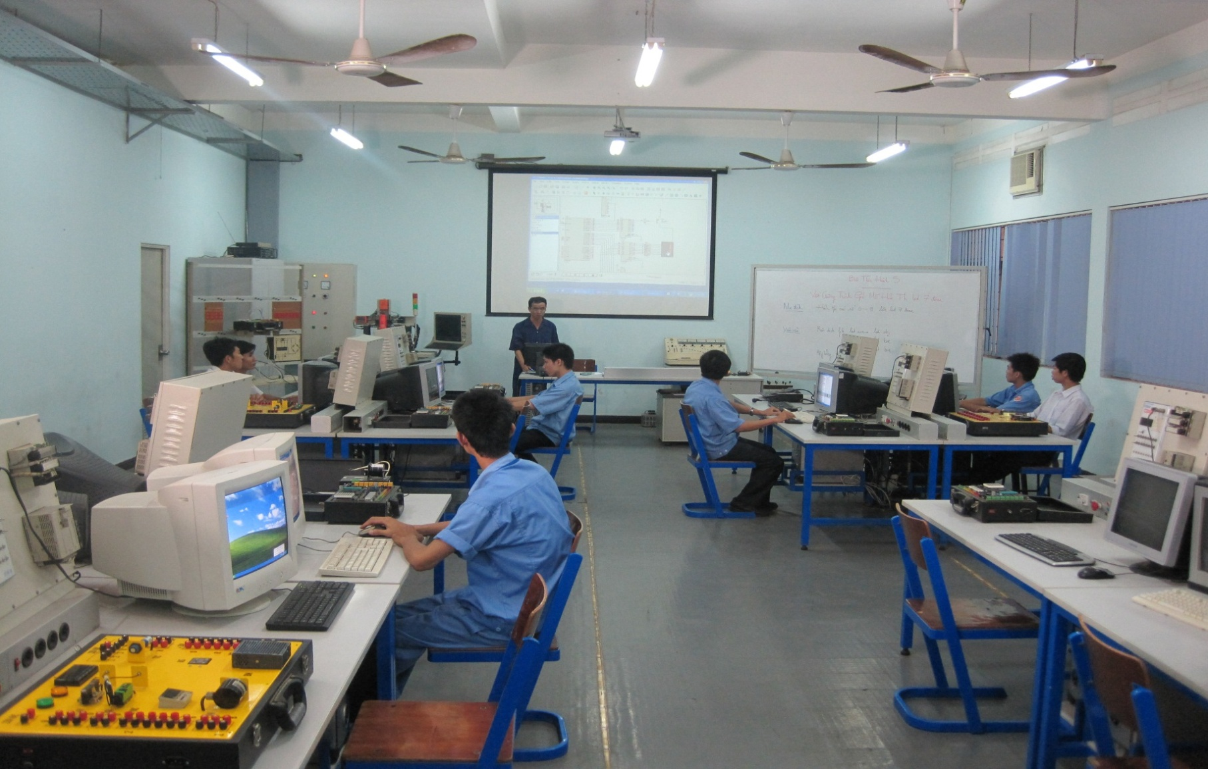
MULTIMEDIA ROOM

Slide 23
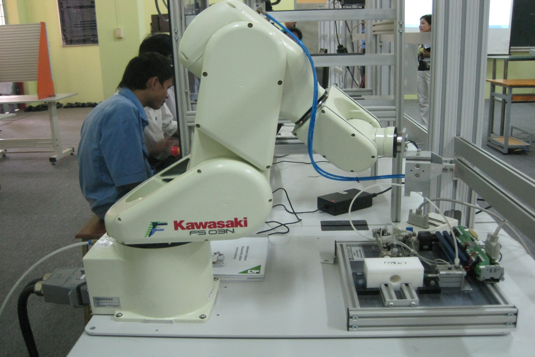
ROBOT PRACTICE ROOM

Slide 24
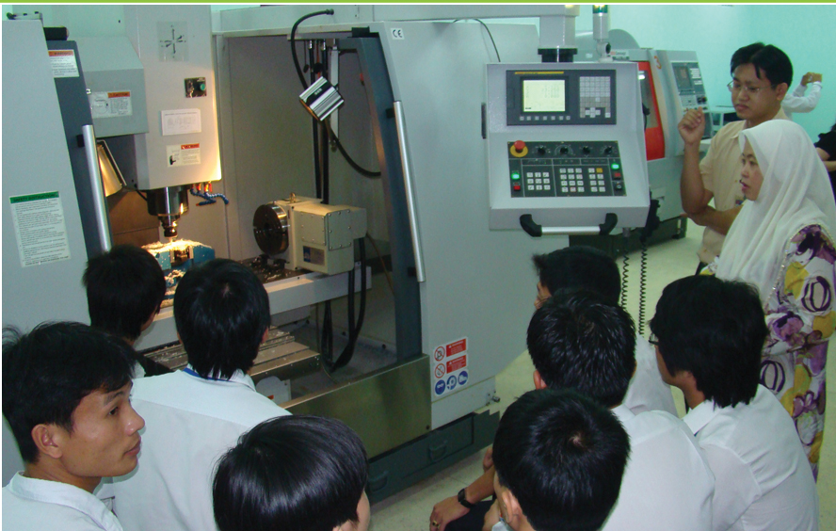
CNC BARON MAX VM20

Slide 25
LY TU TRONG TECHNICAL COLLEGE
HO CHI MINH CITY
390 HOANG VAN THU, WARD 4, TAN BINH DISRICT, HCMC
TEL: (848)-8440567; (848)-4490589
www.lttc.edu.vn

